Slide 1
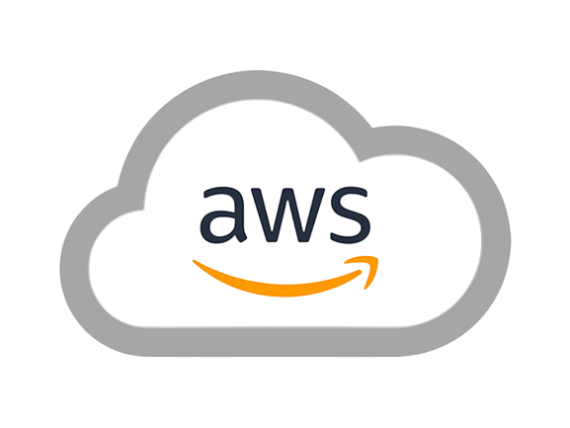
3 Virtual Private Cloud’s
Peering
BY
KORADA VIJAYA ANJALI
ADITYA UNIVERSITY
21A91A6148

Slide 2
INDEX
INTRODUCTION
TECHNOLOGIES USED
Why VPC Peering
DEPLOYMENT
RESULTS
CONCLUSION

Slide 3
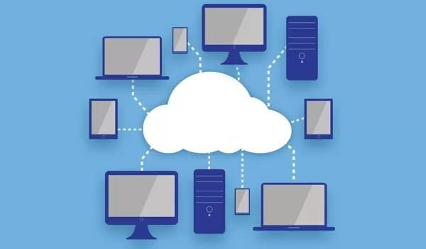
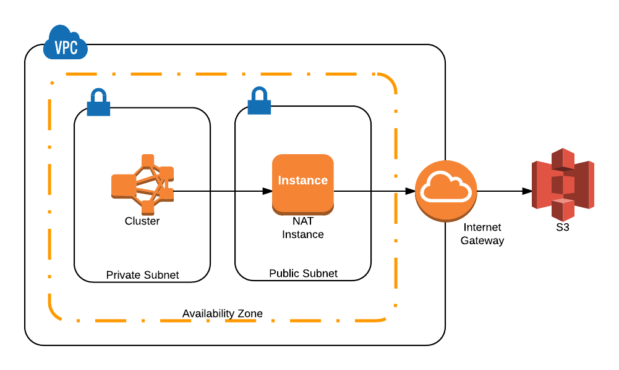
01. Introduction
Cloud is the delivery of computing services including servers, storage, databases, networking, software, and more over the internet ("the cloud").
A Virtual Private Cloud (VPC): is a secure, isolated section of a public cloud where users can launch resources in a virtual network they define. It provides control over the network environment, including IP address ranges, subnets, route tables, and network gateways
Amazon RDS (Relational Database Service): is a managed database service that simplifies setting up, operating, and scaling a relational database in the cloud.

Slide 4
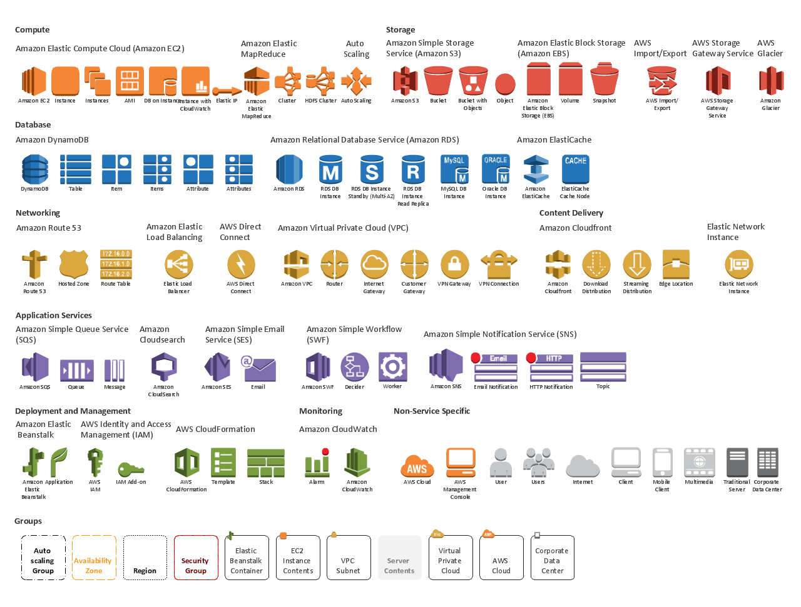
02.TECHNOLOGIES USED
AWS
VPC in different regions
Peering Connection
RDS (MySQL)
EC2

Slide 5
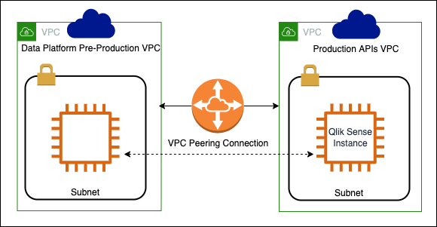
03. Why VPC peering
Private Communication
Cross-Region Connectivity
Cost-Effective
Security
Simplified Architecture
Scalability

Slide 6
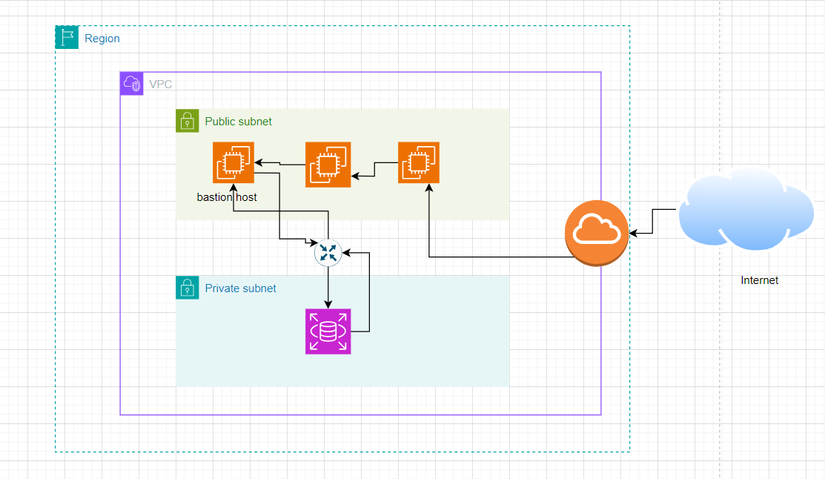
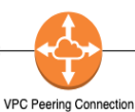
04. DEVELOPMENT

Slide 7
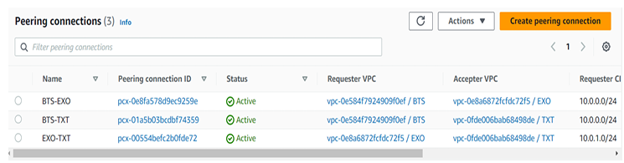
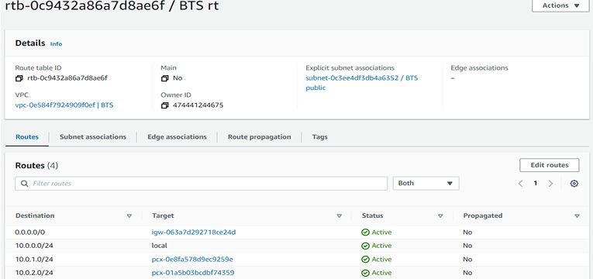
05.RESULTS

Slide 8
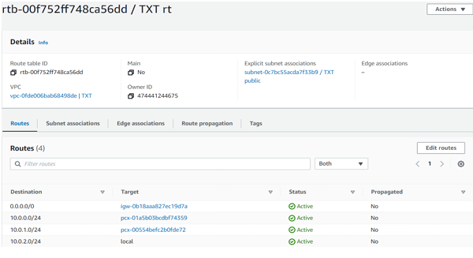
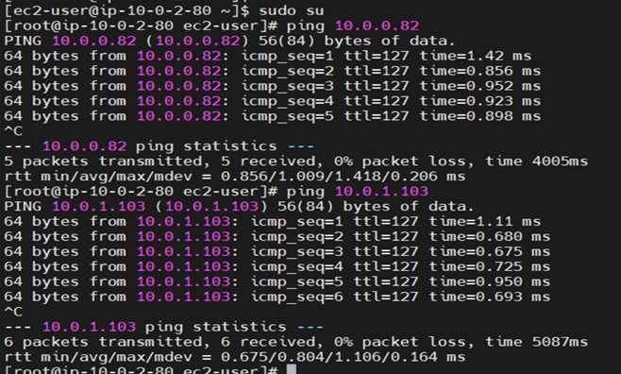
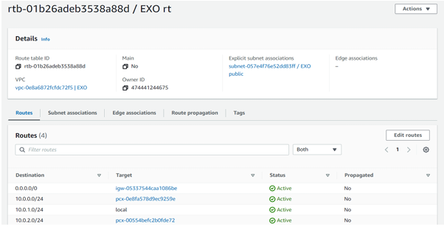

Slide 9
06. CONCLUSION
In this project, I successfully designed and implemented a Virtual Private Cloud (VPC) architecture with distinct public and private subnets to optimize security and functionality. By deploying EC2 instances in the public subnet, equipped with a bastion host, I ensured secure access to the internet and management of resources.
VPC peering is a valuable networking feature in AWS that facilitates secure and efficient communication between VPCs. By allowing private IP address communication, it reduces latency and minimizes data transfer costs, all while enhancing security by keeping traffic within AWS’s internal network. VPC peering simplifies network architecture and supports both intra-region and cross-region connectivity, making it a versatile solution for scalable and cost-effective cloud infrastructure.

Slide 10


